Slide 1

DriverPass
System Analysis
Mark Rossmiller
Notes:
[No speaker notes required for this slide.]

Slide 2

System Requirements
Usability
Reliability
Authentication
Audit Tracking
Notes:
[In your speaker notes, include an explanation of the different requirements you determined for DriverPass’s system. What are the functional requirements you selected to describe? What are the nonfunctional requirements you selected to describe? Be sure to explain how these requirements meet DriverPass’s needs.]

Slide 3
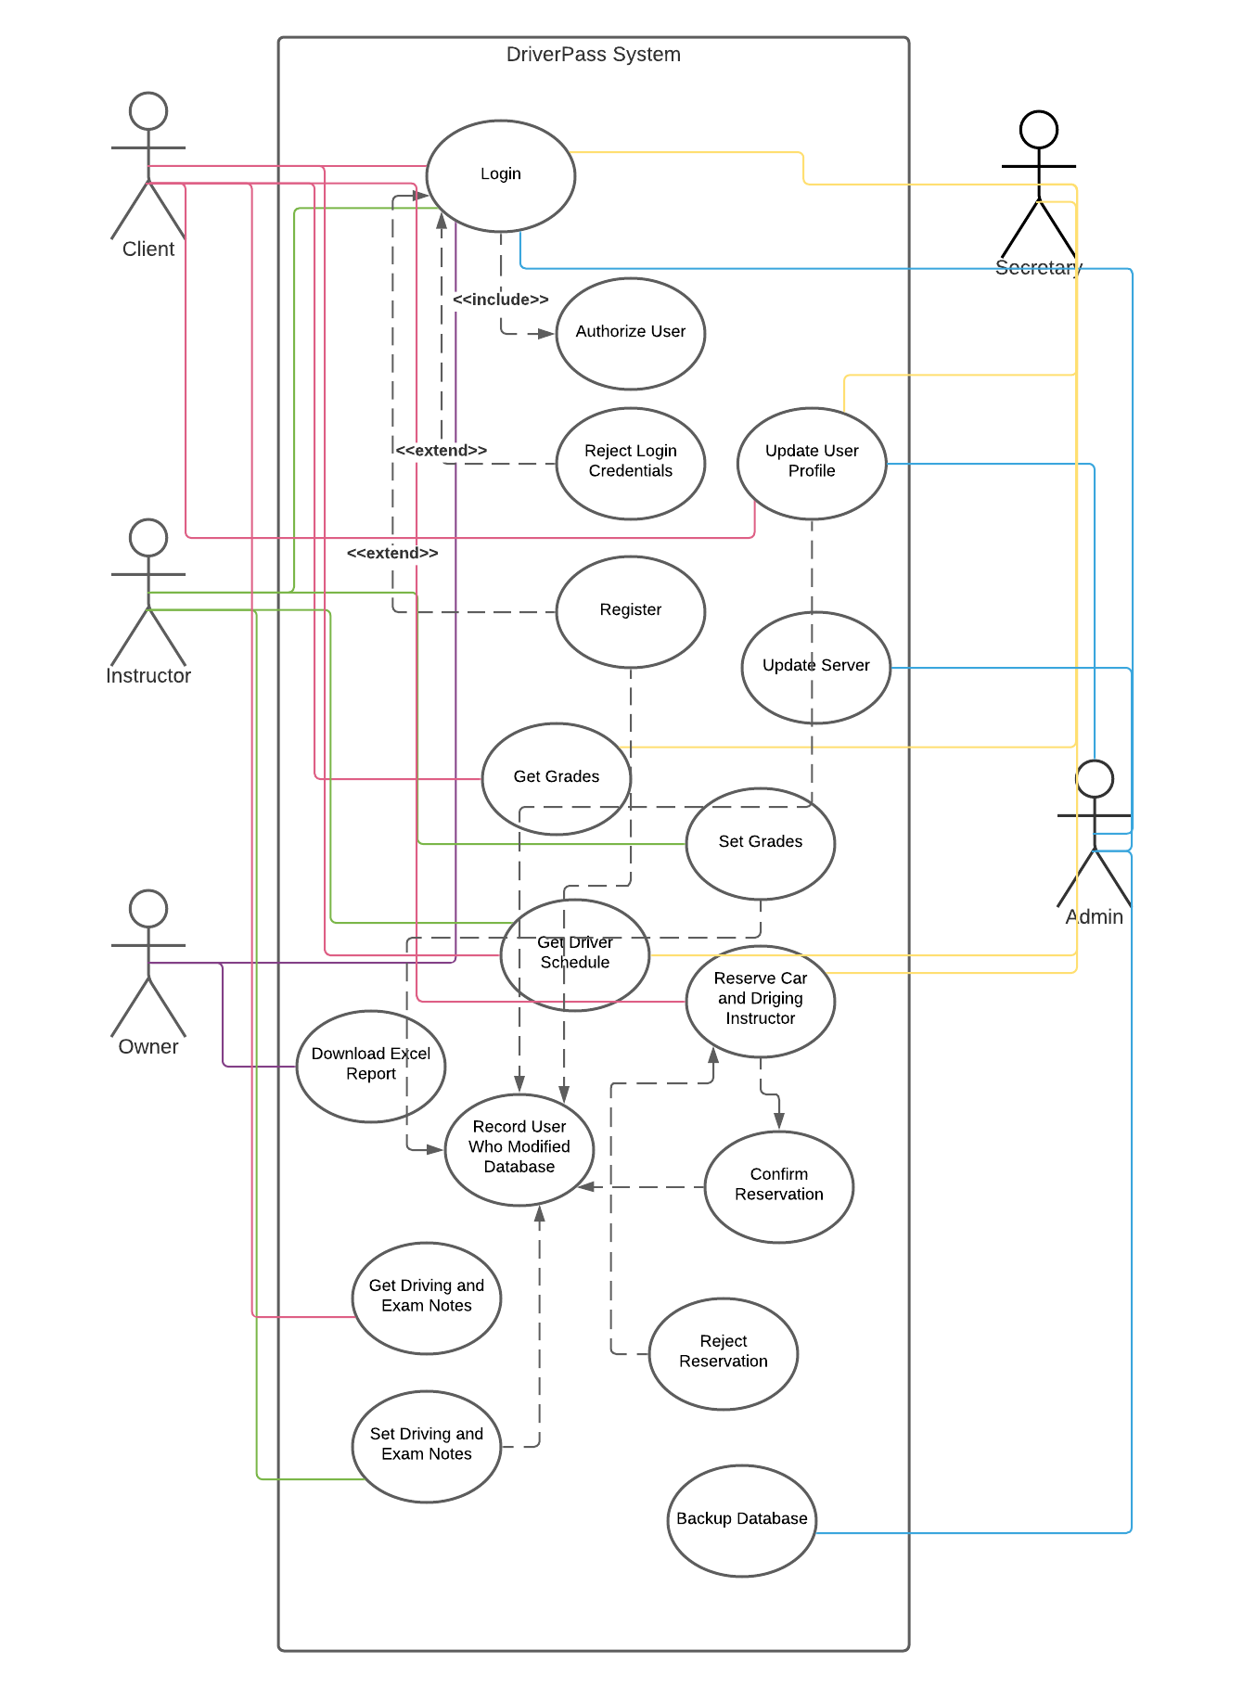
Use Case Diagram
Notes:
[Explain your diagram. Who are the different actors in the system? What are the different use cases? How did you account for DriverPass’s needs in your design? In your explanation, keep your audience in mind. Avoid the use of terms like “actors” and “use cases” in your explanation.]

Slide 4
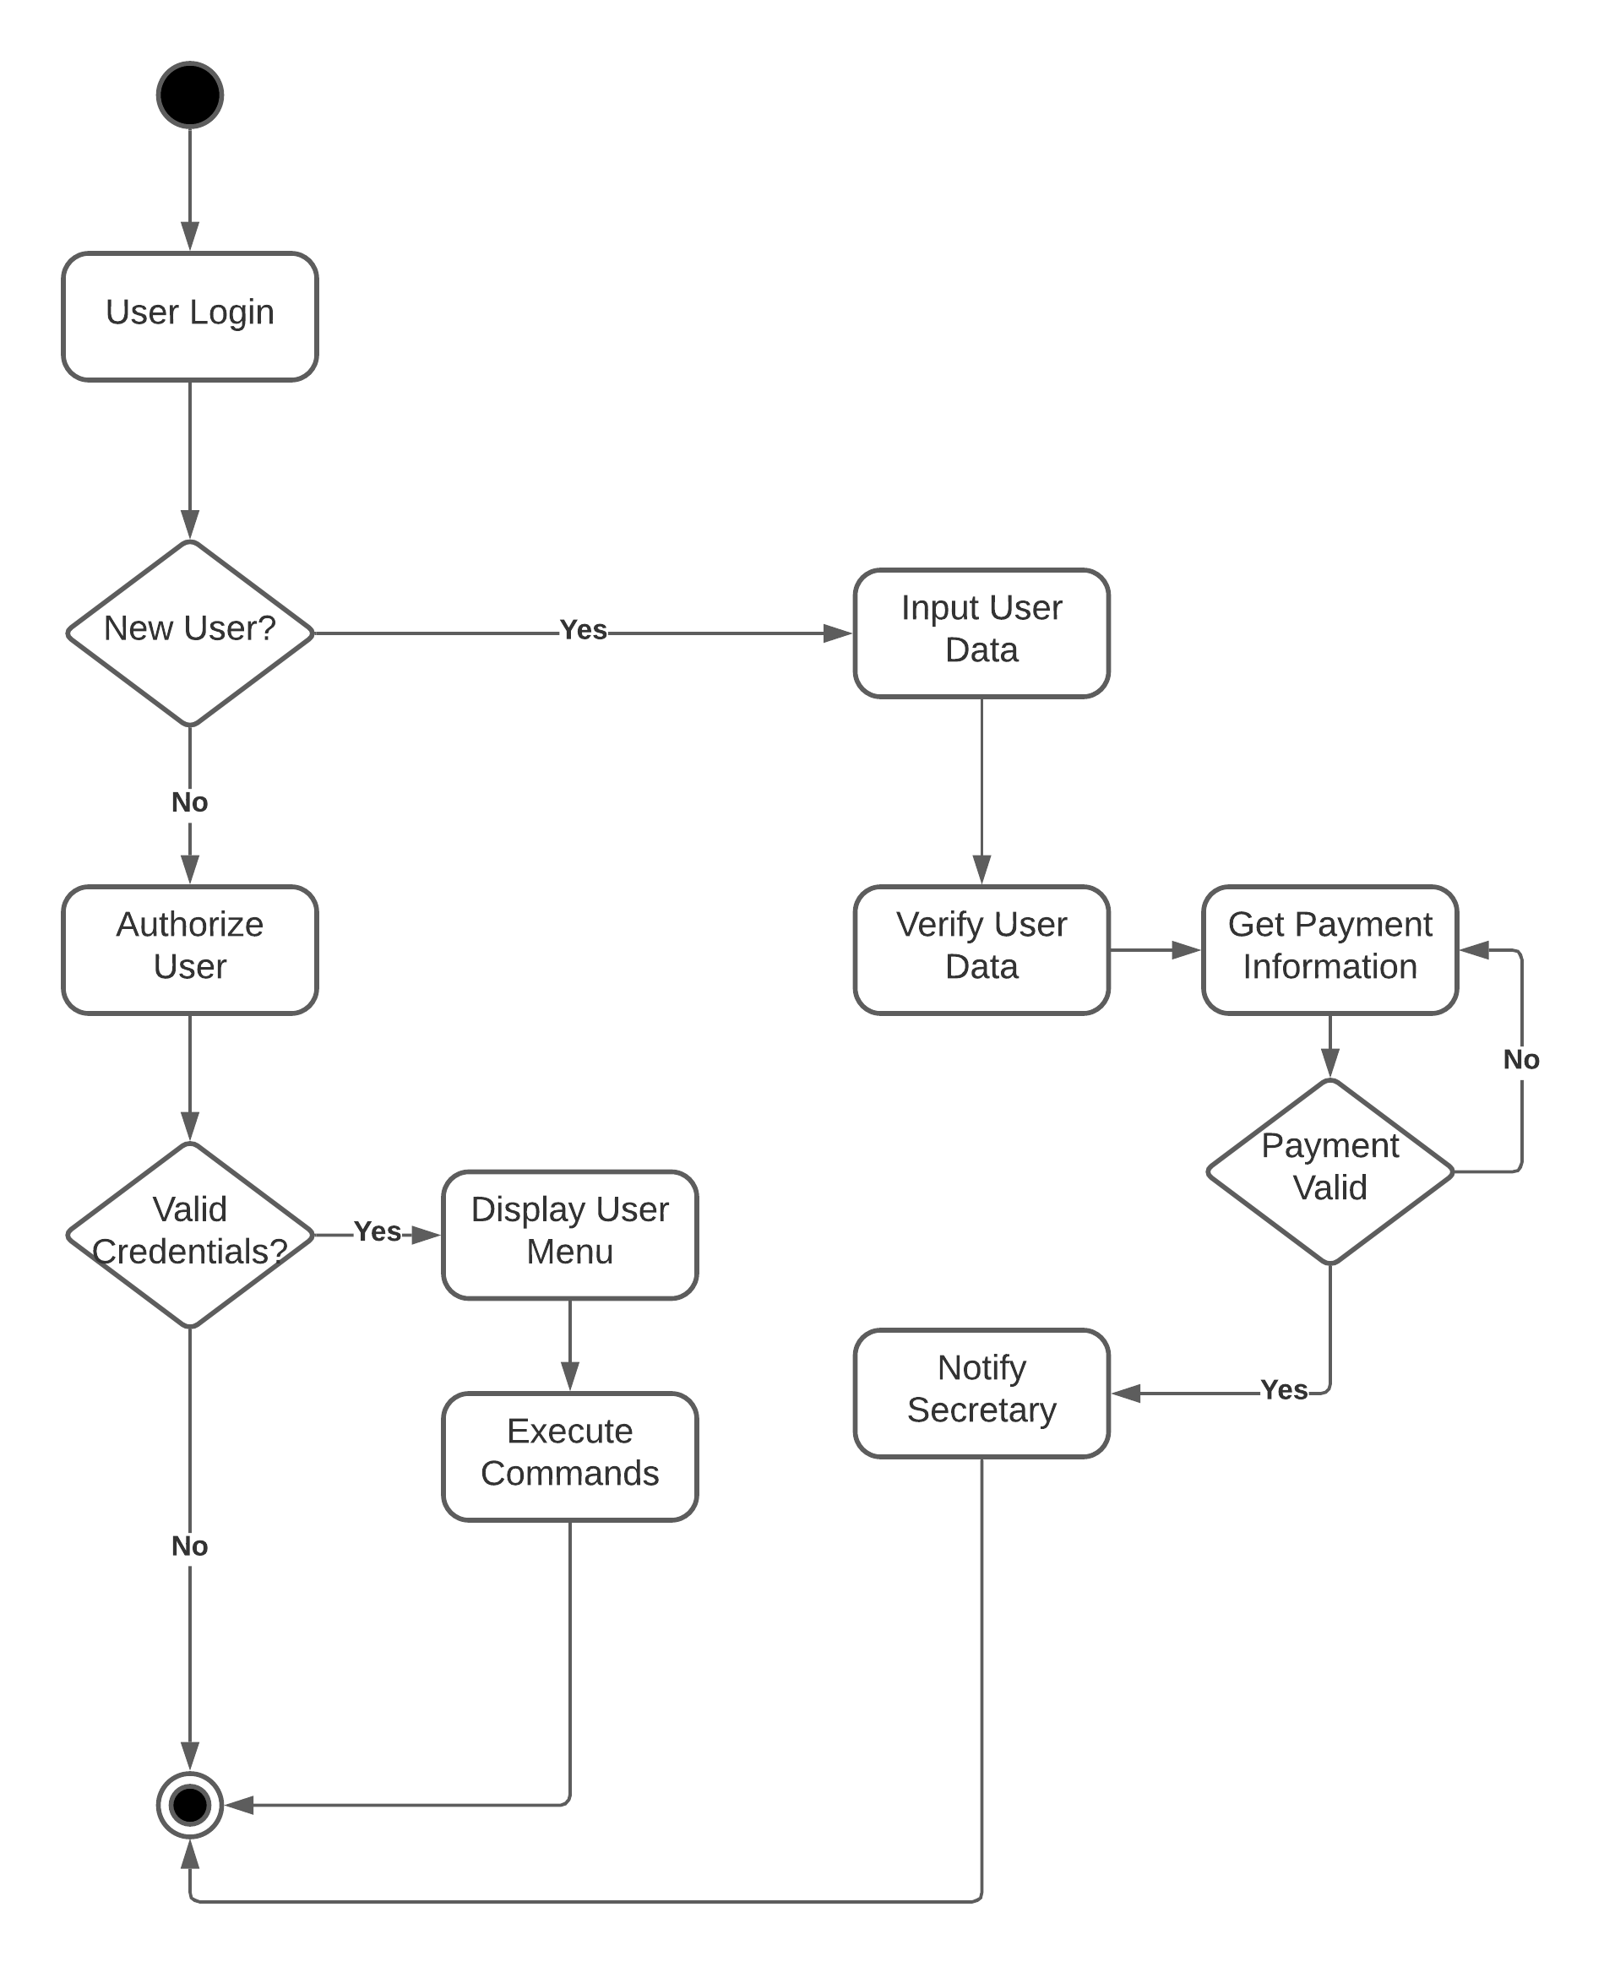
Activity
Diagram
Notes:
[Explain your diagram. Which use case are you breaking down? What are the steps for this use case? How did you account for DriverPass’s needs in your design? In your explanation, keep your audience in mind. Avoid the use of technical terms such as “nodes,” “control flows,” and so on.]

Slide 5
Security
SSL Encryption
Secure Authentication
Secure Password Requirement
2FA via SMS
Notes:
[How did you consider security in your design? In your explanation, keep your audience in mind by avoiding the use of technical terms.]

Slide 6
System Limitations
Budget does not support long-term software maintenance
Few developers
Not developed in an Agile framework
Not scalable
Notes:
[What are the limitations of your design? In your explanation, keep your audience in mind by avoiding the use of technical terms.]

